Slide 1
RefWorks Workshop – Citation Tool
Muna Abdulla
23 October 2018

Slide 2
Outline
Access to RefWorks & Account Creation
Export References
Create a new folder & Organize references into a folder
Create bibliography
Share & Collaborate
Write N Cite

Slide 3
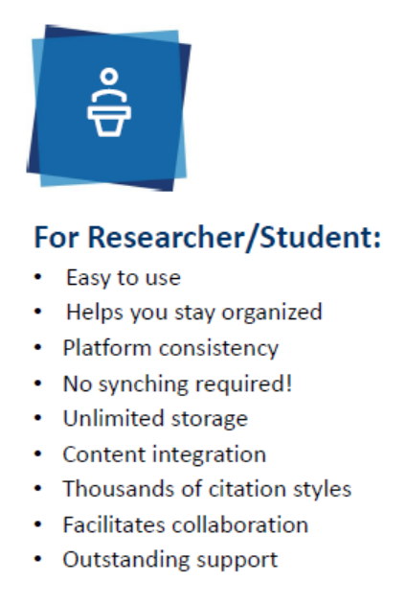
Top Things to remember about RefWorks

Slide 4
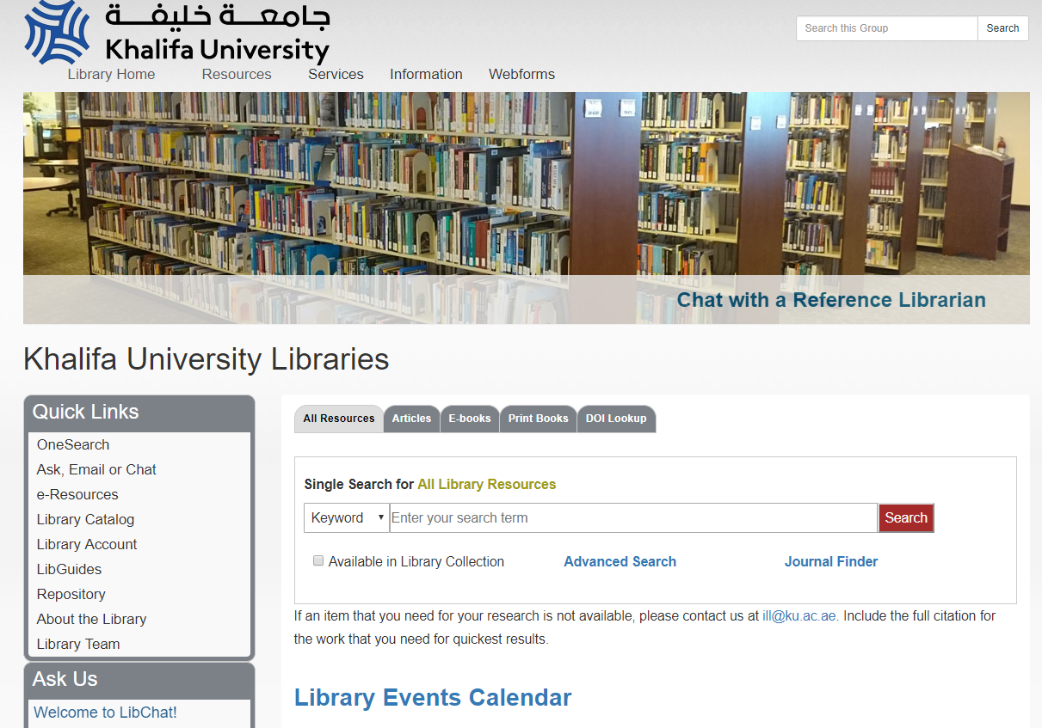
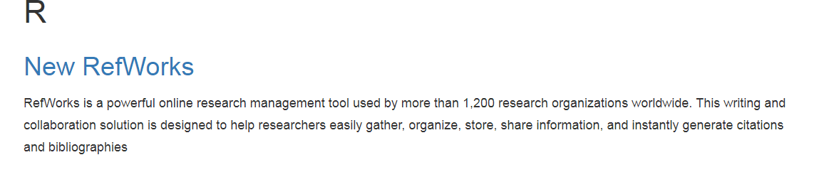
Access to RefWorks & Account Creation
http://libguides.kustar.ac.ae/lib

Slide 5
Live Demo

Slide 6
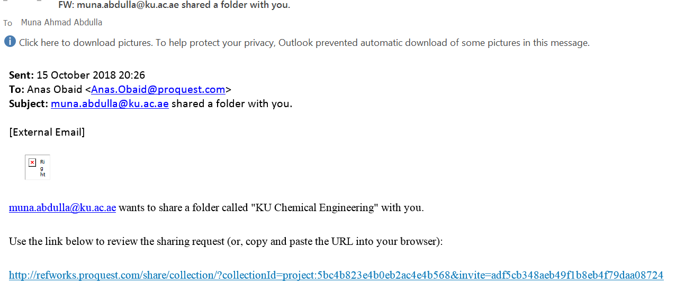
Share & Collaborate

Slide 7
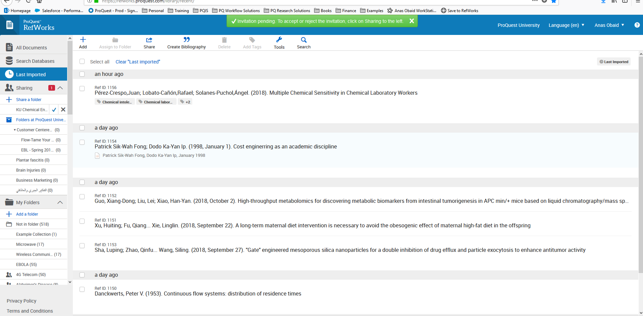
Share & Collaborate

Slide 8
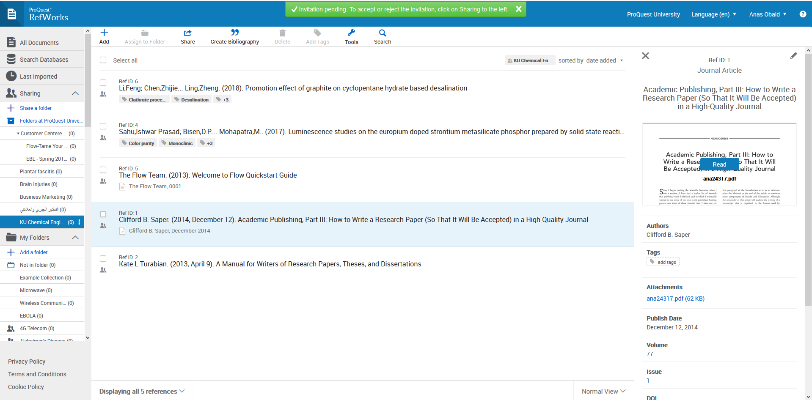
Share & Collaborate

Slide 9
How I can Learn More?

